Slide 1
WEB BASED ATTENDANCE MANAGEMENT SYSTEM FOR COLLEGES
By
Y.Durga Prasad
B.Sravan Kumar

Slide 2
Introduction
The Student Attendance Management mainly concern with the access control data, easy to maintain the data.
It is a easy process to check the Student attendance from anywhere.
This is Web based Attendance Management.

Slide 3
Staff can easily take the attendance and maintain the attendance.
It has Three modules.
Admin
Staff
Student
Admin
Admin can Add, Delete, Update and View the Students And Staffs details.

Slide 4
2. Admin can assign the class teachers.
Staff
Staff members will take the students attendance.
Teachers can check their class students details and attendance.
Students
Students will check their attendance percentage, total presents, absents etc.

Slide 5
Existing System
scope:
Time consuming.
Consumes lots of manpower for better results
lack of data security
More errors in calculations, inter mixing of student attendance, lot of confusions in student data.

Slide 6
Proposed system
The website makes the overall project management much easier and flexible.
Students Attendance can be easily updated for every month.
Students, parents and staff can view student attendance monthly.
In this each student data will be stored in tables in database. This avoids the inter-mixing of data, confusion.
You can easily understand the student attendance.

Slide 7
Software Requirements:
Operating System : Windows 7
Technology : Java/J2EE
Web Technology :HTML,CSS ,JavaScript
IDE/Workbench : Netbeans
Web Server : Tomcat
Database : MySql

Slide 8
Hardware Requirements:
Processor : Pentium 4
RAM : 1GB
Hard disk : 40GB

Slide 9
ER Diagrams
Admin
ADD
Student
Update
Admin
Delete
Staff
Database
View
Notification Update

Slide 10
Staff
View Profile
Student Details
Update Attendance
Staff
Database
View Attendance
Change Password

Slide 11
Student
Student
Attendance
Database

Slide 12
Home Page
Home
Notifications
Student Info
Login
About Us
View
Notificaions
Attendance
Staff
Admin
Student
Attendance
Student details
Profile
Settings
Add
Update
Delete
View
Notifications Update
Log
out
Change
Password
Logout
Student
Staff
View
Update
Database

Slide 13
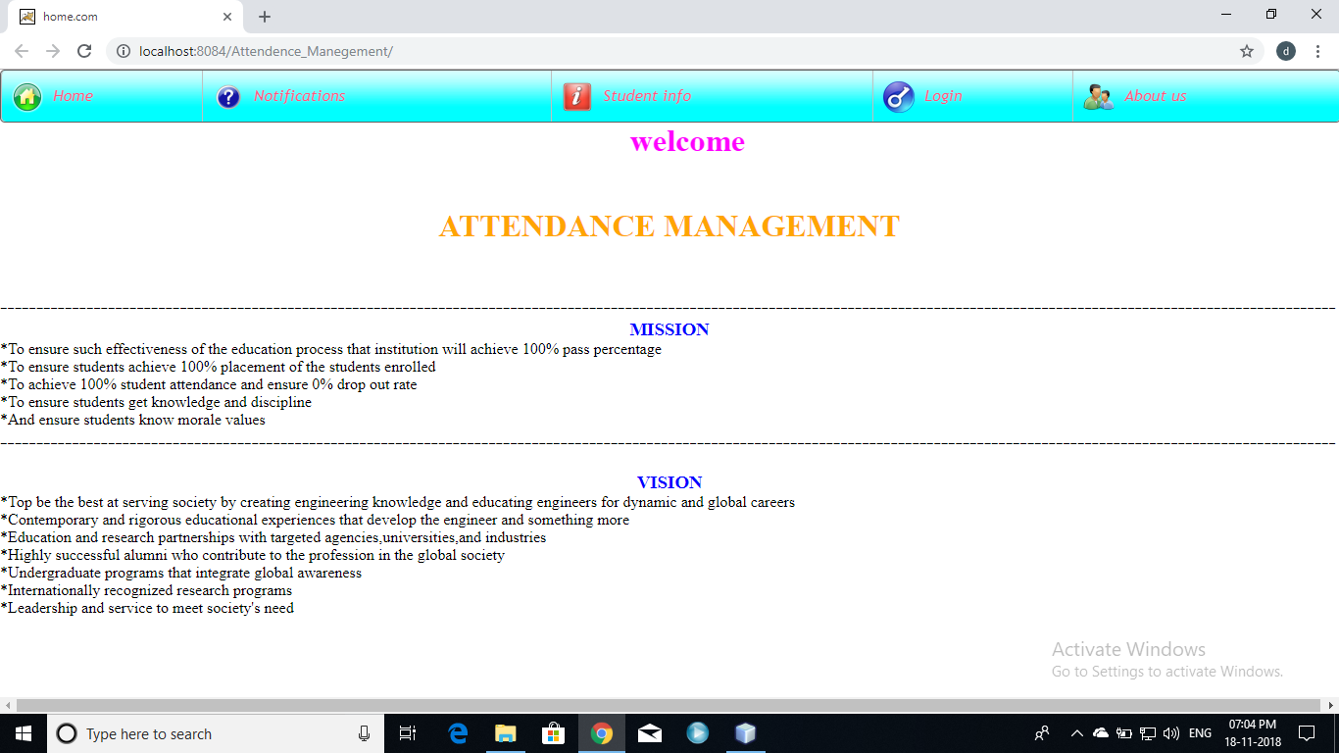

Slide 14
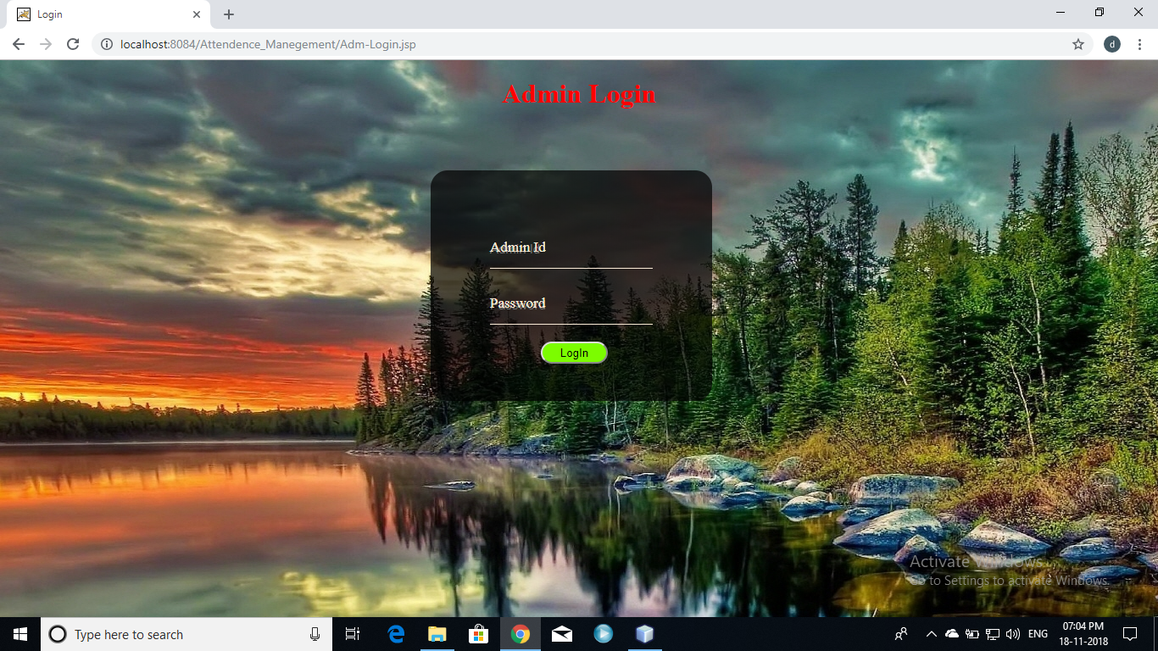

Slide 15
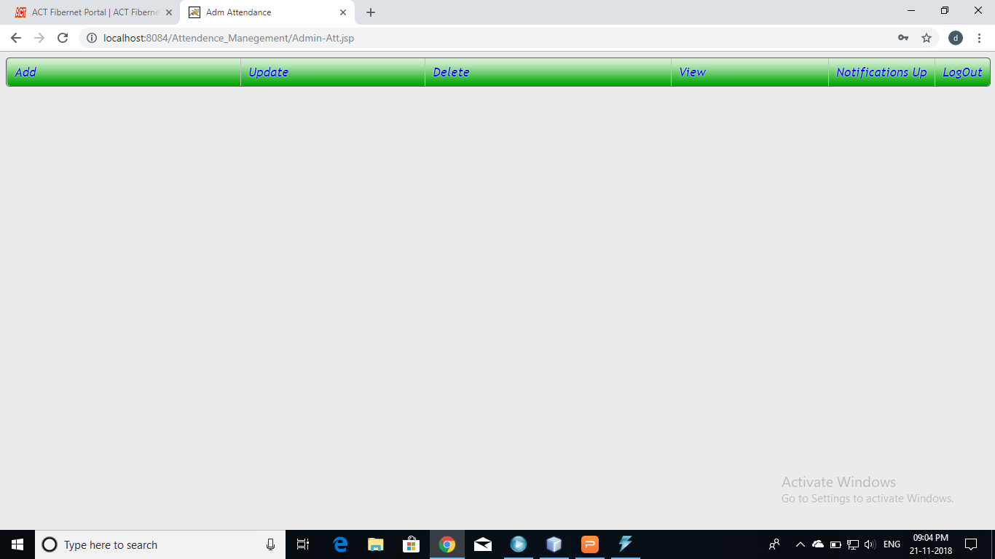

Slide 16
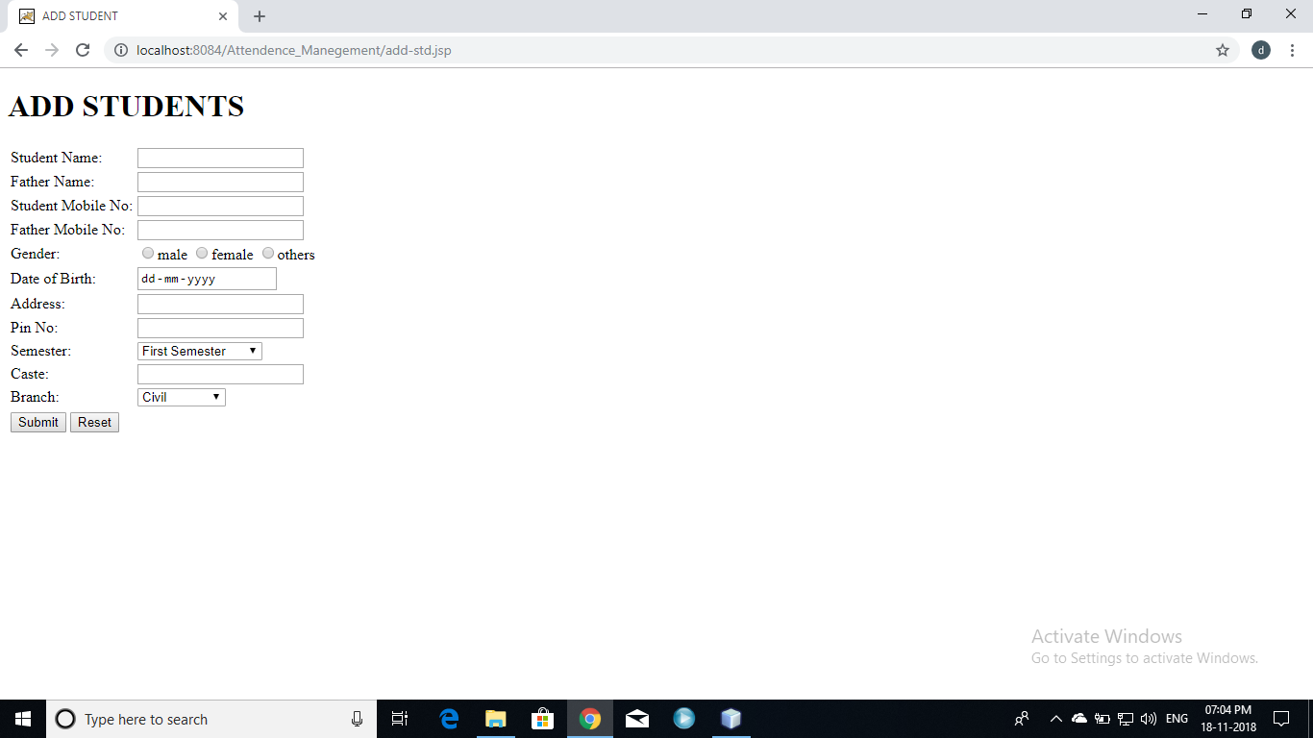

Slide 17
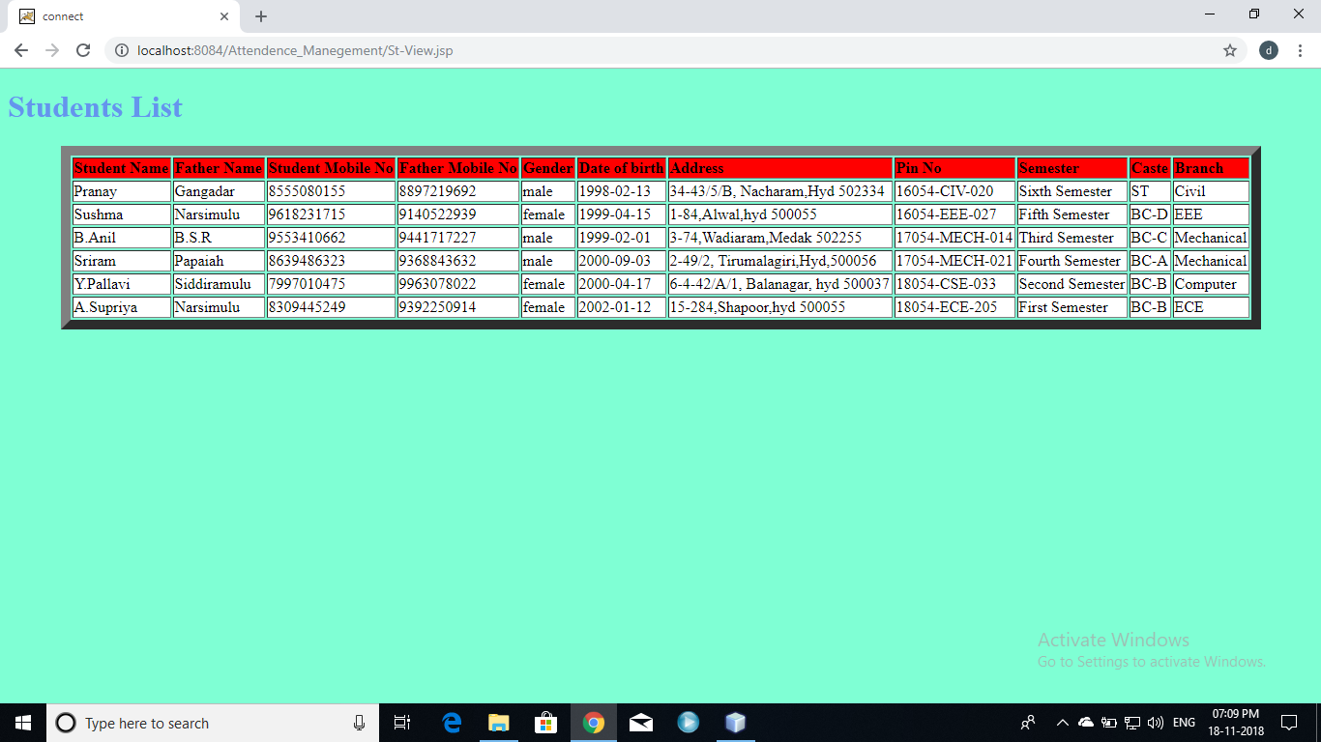

Slide 18
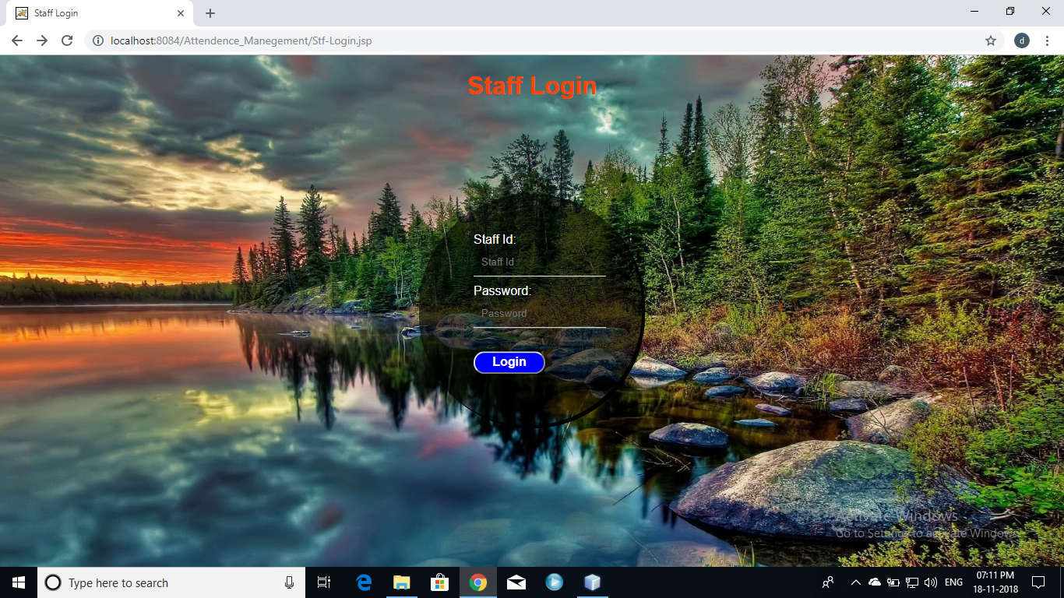

Slide 19
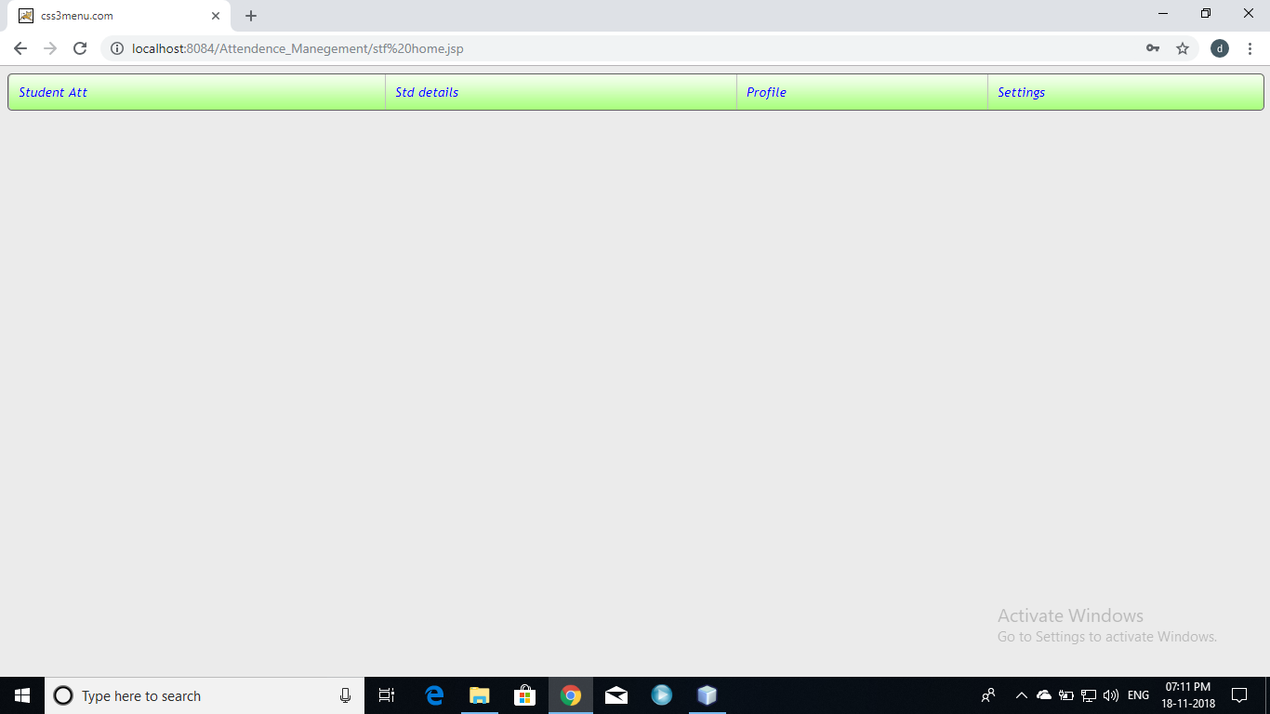

Slide 20
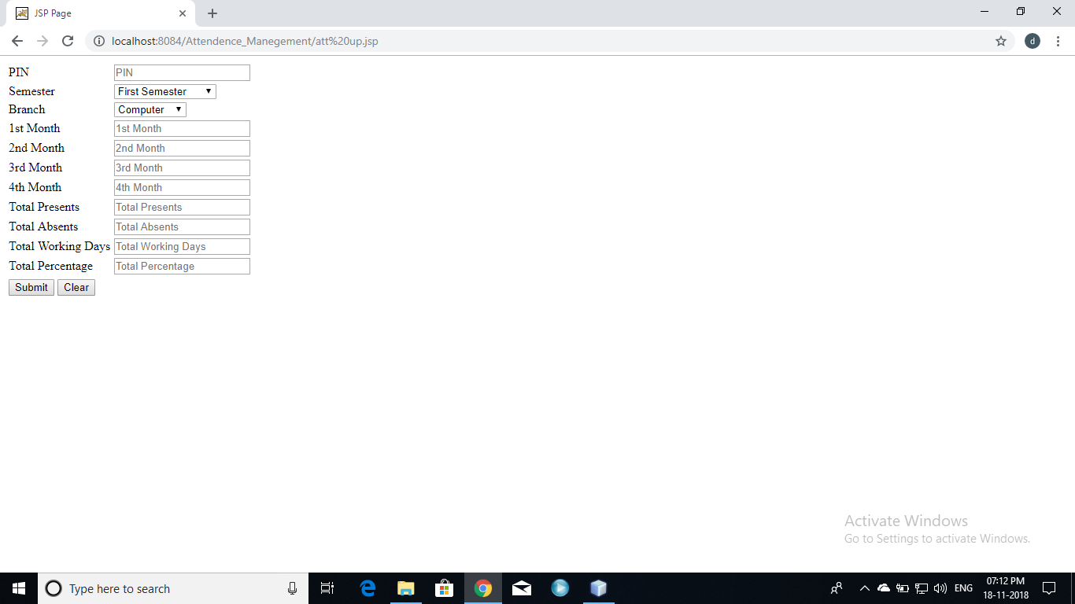

Slide 21
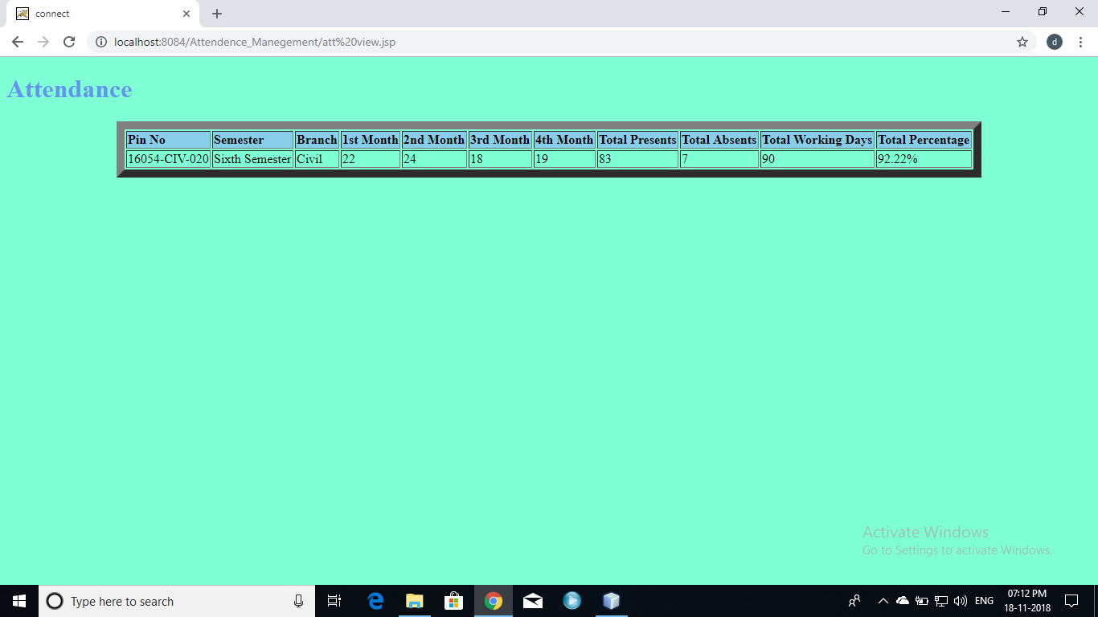

Slide 22
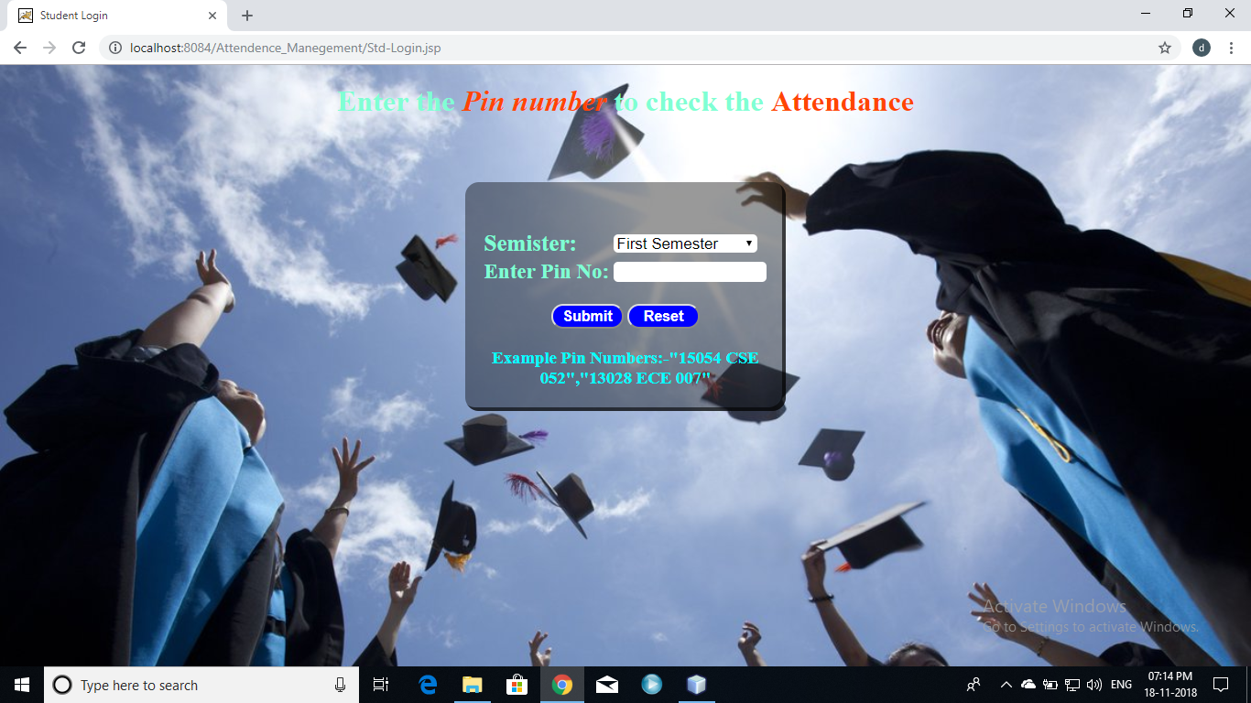

Slide 23
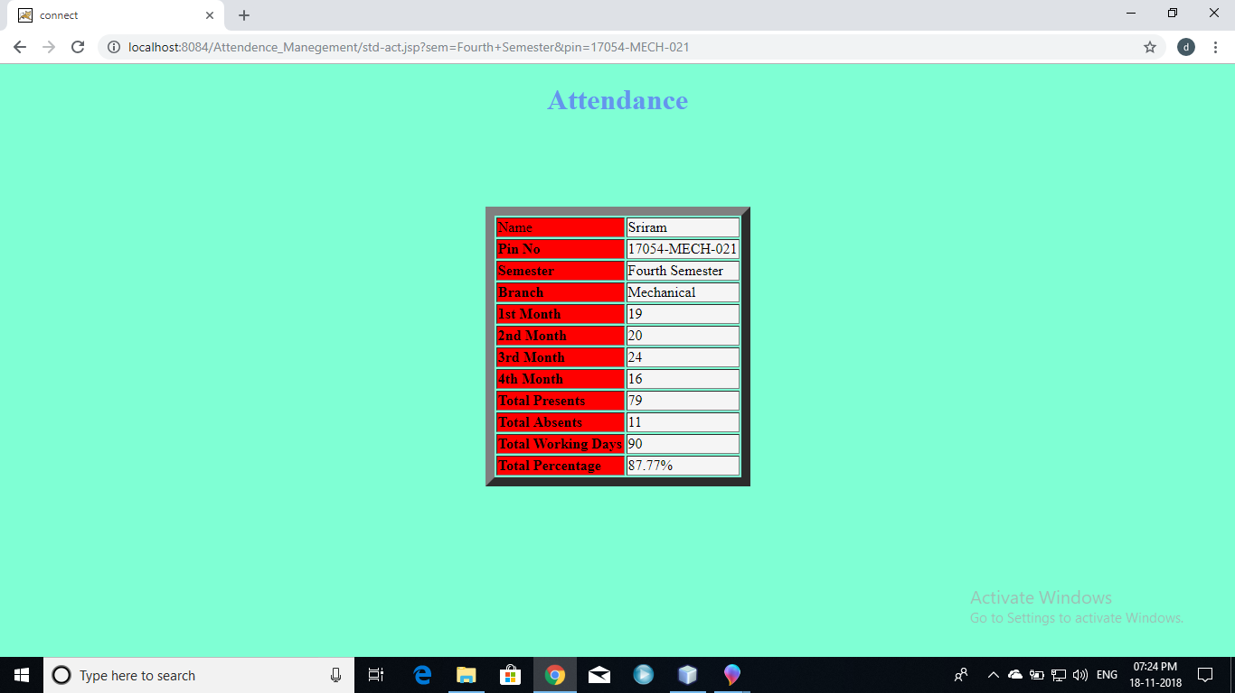

Slide 24
Thank you

